Slide 1
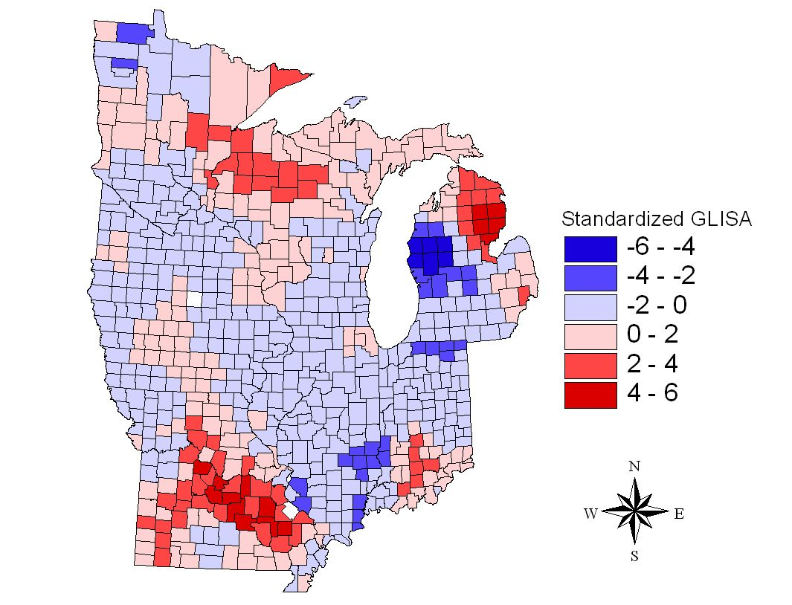
Spatial autocorrelation
Geog4300/6300
Jerry Shannon

Slide 2

Spatial autocorrelation:
A measure of how a set of spatial features are clustered or dispersed over space.
Tobler’s first law of geography (1979):
“Everything is related to everything else, but near things are more related than distant things.”

Slide 3
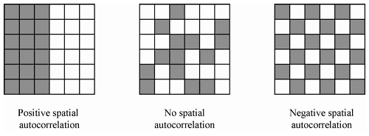
DataUrbanist

Slide 4
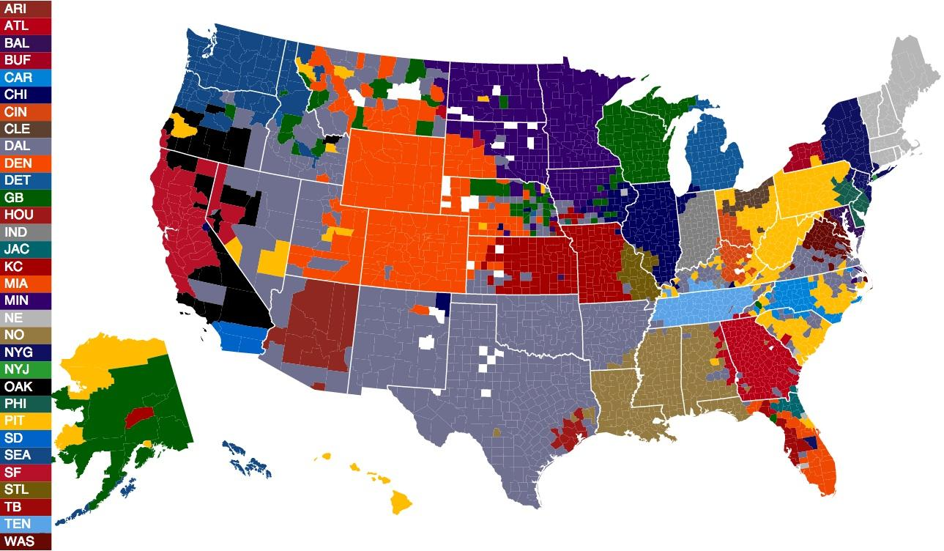
NFL team loyalty measured through Facebook

Slide 5
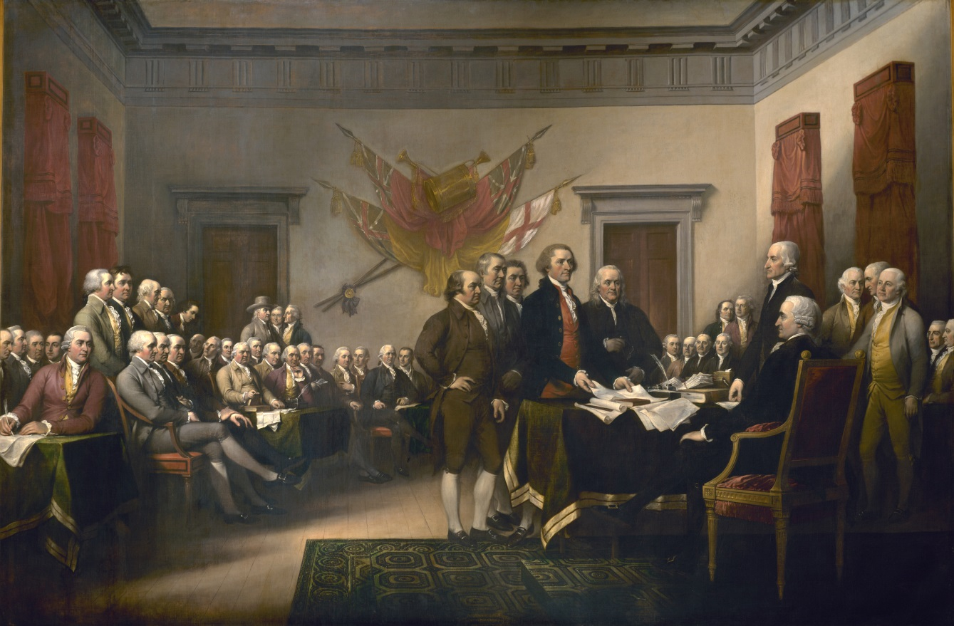
Why do we care?
Conventional statistical models assume independent observations.
Spatial autocorrelation violates that assumption and require adjustment of the model.
A different kind of independence

Slide 6
Spatial autocorrelation can point to two conceptually different issues:
Spatial dependence: Clustering of high values in certain regions Suggests underlying spatial process (e.g. exposure to toxins/viruses)
2. Spatial heterogeneity: Relationships between variables change across space Indicates the presence of spatial regimes that must be accounted for (e.g., policy differences; cultural variation).

Slide 7
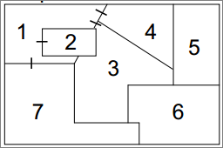
Spatial dependence requires a way to measure neighborhood influence
Who is my neighbor?
How can we answer this question?
Neighbors can be measured through adjacency/shared borders
Neighbors can be measured through distance

Slide 8

Spatial dependence is modeled through weight matrices
Let’s assume we’re using queen weighting for only the first band of neighbors.
Who are the neighbors for area 1?
Areas 2, 3, 4, and 7
That can be represented in a matrix:

Slide 9
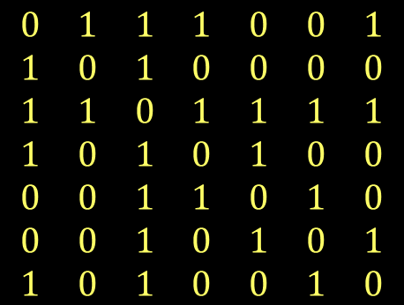
Spatial dependence is modeled through weight matrices
The completed matrix would look like this:

Slide 10
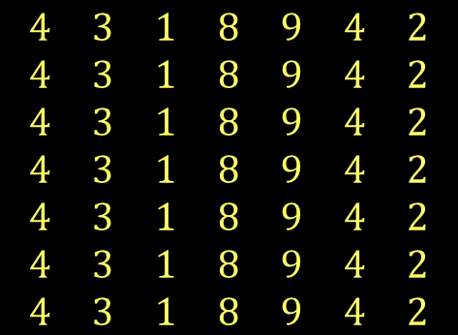
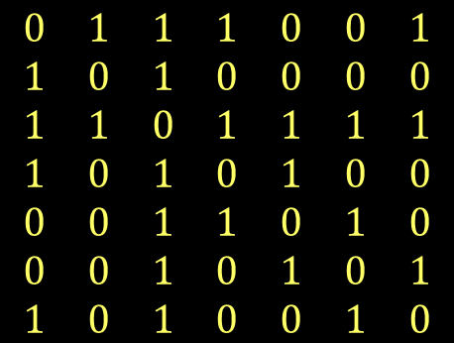
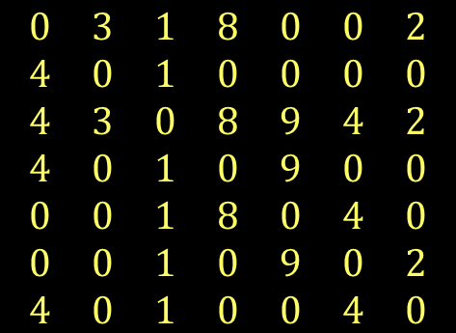
The values for areas 1-7 can be multiplied by this matrix and averaged
X
=

Slide 11
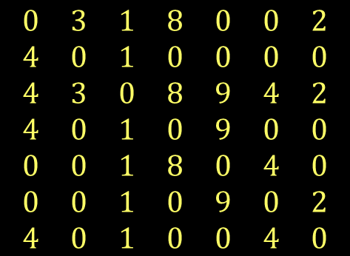
Average each row to see what the mean neighbor value is.
3 + 1 + 8 + 2 = 14
14/4 = 3.5
4+ 1 = 5
5/2 = 2.5

Slide 12

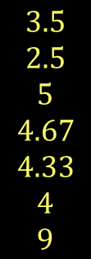
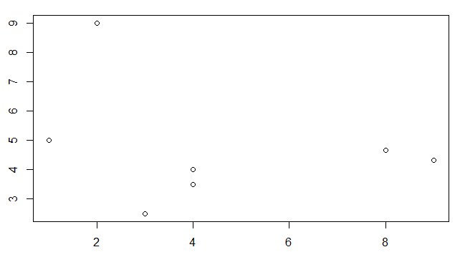
Plot the original values against their mean neighbor value.
Are they associated?
The negative slope indicates negative autocorrelation

Slide 13
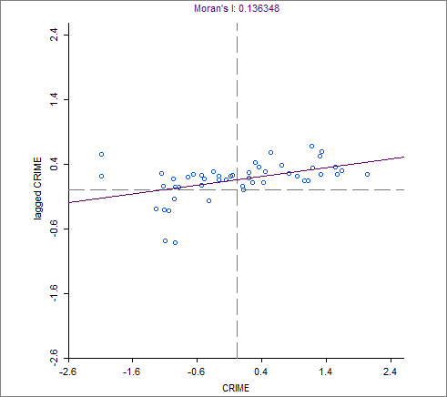
The Moran’s I statistic is a global measure of autocorrelation that uses these weights.
Varies between 0 and 1.

Slide 14
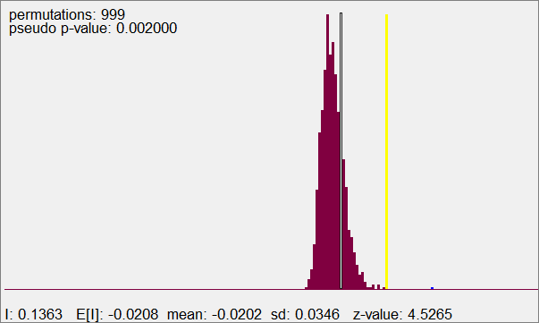
The significance of the Moran’s I statistic is determined by randomly placing data values on a map and measuring how often the actual configuration appears (a Monte Carlo method).

Slide 15
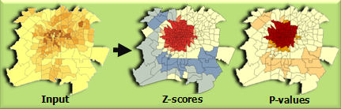
Getis-Ord Gi* is one measure of local spatial autocorrelation.
It creates a z-score for the value of an observation and its weighted neighbors based on all observations.
https://desktop.arcgis.com/en/arcmap/10.3/tools/spatial-statistics-toolbox/hot-spot-analysis.htm

Slide 16

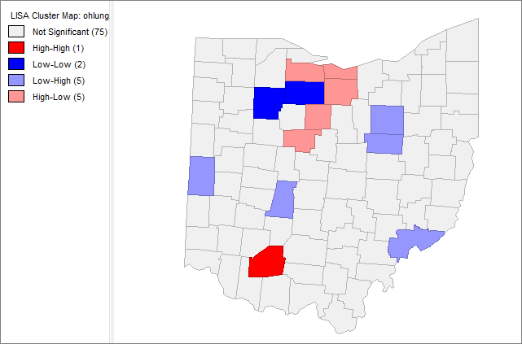
Luc Anselin (and others) developed the Local Indicator of Spatial Autocorrelation (LISA) to find clustering at the local level.

Slide 17
LISA holds the value of a given area fixed and runs through permutations for all other areas.
How likely is it that actual distribution around that area is random?

Slide 18
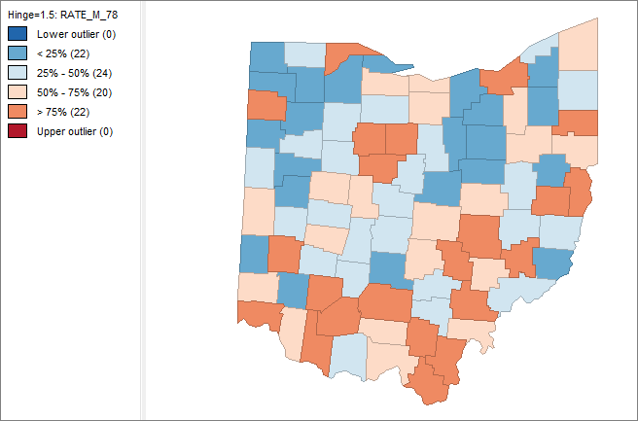
Rates of lung cancer for men in Ohio, 1978

